Slide 1
Multi Dimensional Analysis of EEG Signals

Slide 2
Outline
Brain signals
How they are captures.(History, new way of capturing the signals)
1D analysis
List the ways it’s done
Raw signals into CNN
Classification based on non -linear features(hand crafted features)
Preform feature selection then classification on it.
Explain how they are done(preprocessing,dwt,composite features,classifiers)
Main things - spectral decomposition to exploit spectral info.(DWT),composite feature set.

Slide 3
Outline
2D analysis
List the ways it’s done
2D feature maps(ASPP+FPN)
2D feature maps + 1D feature composite set(FC Network)
Explain how they are done(ASPP+FPN)
Main things - ASPP+FPN,explioting the spatial info(AEP,DTLI)
3D analysis
List the ways it’s done
CNN-LSTM
FPN-LSTM
Main things - spatial ,spectral,temporal are exploiting together.

Slide 4
Outline
Evaluation metrics
Loss function
Optimizer
Learning rate
Spliting of dataset
Datasets
EEG baseline
Mental arithmetic dataset
Parkinsons
Emotion dataset

Slide 5
Outline
Results
Dataset,Author,Representation,Accuracy
Reasons
EEG baseline why 3d is good
Mental arithmetic why 3d is good
Parkinsons why 1d is good
Emotion why 2d+1d is good
Takeways

Slide 6

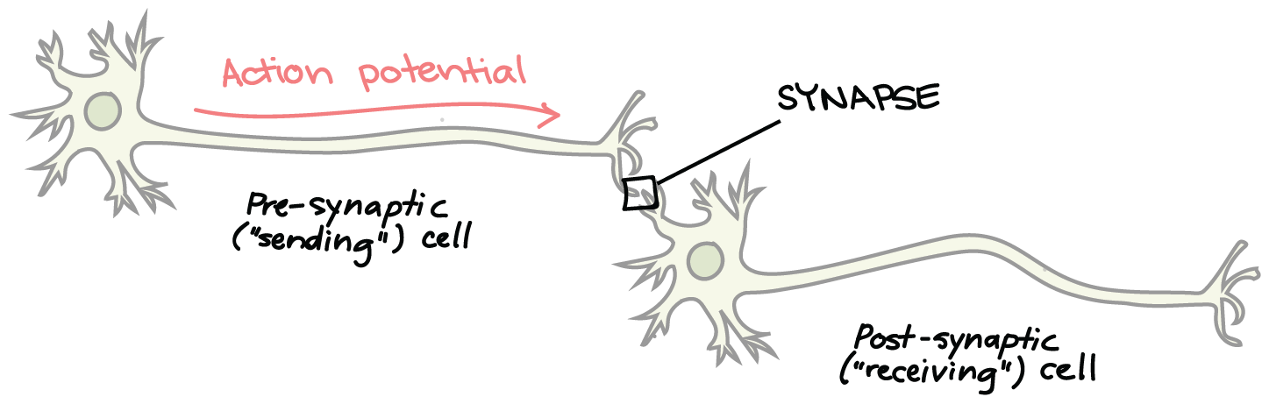
Background - EEG
EEG : Captures the electrical activity happening in the brain
Electrical activity happens because of Neuron communications.
So Electricity flows.
So Potential Difference Exists.
EEG measures the Potential Difference.
Previously done with 2 electrodes one for reference one at other end.
Now 64 electrodes on scalp and one for reference.
Note: Potential is a referential quantity. EEG is non invasive technique.
Notes:
Suppose if our leg was hit by a stone then the sensation and pain at the toe is transferred to our brain within seconds right.
It is done through neurons.
Neurons are spindle shaped
Communications happen within neuron - electrical signal
Communications happen between neuron - chemical signal
Basically there exist electricity in our body so there must be potential difference between two points.
That fluctuation of potential are measured in eeg test.
EEG test - conducted two electrodes one for reference and other at other end.
Now devices are equipped with 64 electrodes, and having one reference point.

Slide 7
Objective of Paper
Aim is to investigate which representations of data and which models are suitable for classification of EEG based datasets.

Slide 8
Background for 1d analysis
Artifacts : While performing EEG, our signal may get contaminated by undesired noise.
Extrinsic - faulty electrodes, environmental noise.
Intrinsic - eye movements,eye blinks.
Intrinsic Artifacts
Ocular - caused through eye movements
Muscle - sniffing, swallowing
Cardic - heart expansion,contractions
Removal Techniques
Extrinsic - are removed by proper planning and applying filters on signals.
Intrinsic
Regression
Wavelet
BSS
PCA
ICA
CCA

Slide 9
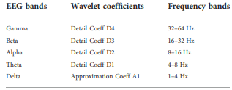
Background for 1d analysis
DWT : used to decompose EEG signals into various sub bands

Slide 10
Background for 1d analysis
Hand Crafted features : we need to prepare features that encapsulated certain characteristics of EEG signals so author prepared few features and experimented out and found top 5 best performing features
Differential Entropy : Measures the signal complexity
Hurst Exponent : evaluates the absence/presence of long-range dependencies.
Hjorth Activity : measures the average power of the brain regions in comparison with other brain regions.
Hjorth Complexity : measures of changein frequency of the signal. similarity of EEG signals at different brain regions to a pure sine wave.
Hjorth Mobility : captures the deviation in the power spectrum of different brain regions.

Slide 11
Pre Processing
1.Remove artifacts
2. Down sample to 128HZ
3.Shape : N*T
Raw Signal
Shape : N*T
DWT
Shape : N*5*T
Classifier
KNN
SVM
RF
AB
Generate Hand craft Features
Shape : N*5 for each feature
Features :
Hjorth complexity
Hjorth mobility
Hjorth activity
Hurst Exponent
Differential entropy
Individual Features
Sent to clasifier
INPUT : N*5(310)
This way we find out Which features are performing better with which classifiers.
This way we form feature set with 4 features and perform feature selection.
Feature Selection
Stack all N*5 of all features(1240)
Select only 80 for classification
Composite Feature set
Hjorth params and Differential Entropy.

Slide 12
Background for 2d Analysis
Azimuthal Equidistant Projection : Technique to project 3d space points onto 2d space(polar projection) (mapped onto 200*200 matrix)
Delaunay triangulation Interpolation Technique : only at few location we will have activity but in general at all locations there will be activity so we interpolate values to that locations.

Slide 13
Representation of 2d Feature maps
Values calculated for each of the hand-crafted features for each of the sub-bands are placed at the transformed 2D location of the electrodes. Positions of the electrodes are mapped on to a 200*200 matrix.
INPUT SHAPE: 200*200*5 for each feature
INPUTS FOR FC NETWORK: 200*200*5 for each feature

Slide 14
2d and 2d+1d
ONLY 2D : ASPP + FPN features are max plooed and flatten at sent ot sense and softmax layers for classification.
2D+1D : features of 1d hand crafted are also merged with 2d feature maps for classification.

Slide 15
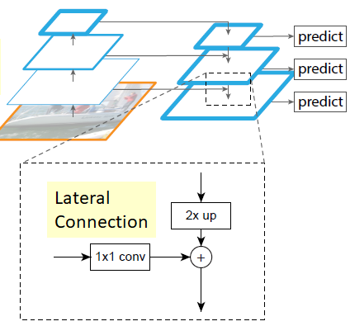
FPN(Feature pyramid Network)
It’s a feature extractor.
Extracts features from multiple scales.
DATA FLOW:
BOTTOM-UP : Computes feature hierarchy at several scales. GOing up features of high level structures are detected.(Semantics are richer).)
TOP-DOWN : Takes high level features and upsanples and enhances with features from bottom up using lateral connections.
Lateral Connections : upsamples of top-down and reduces the channels of bottom up and add them together.
3*3 conv applied to it for reducing the aliasing effect of upsampling.

Slide 16
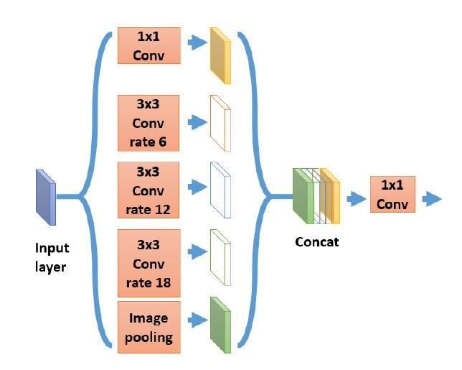
Background of 2d analysis
SPP: Captures multi scale features
Loses pixel details where segmentation is not possible
Hence ASPP comes
ASPP:
Substitute normal pooling layers with atrous conv layers.

Slide 17
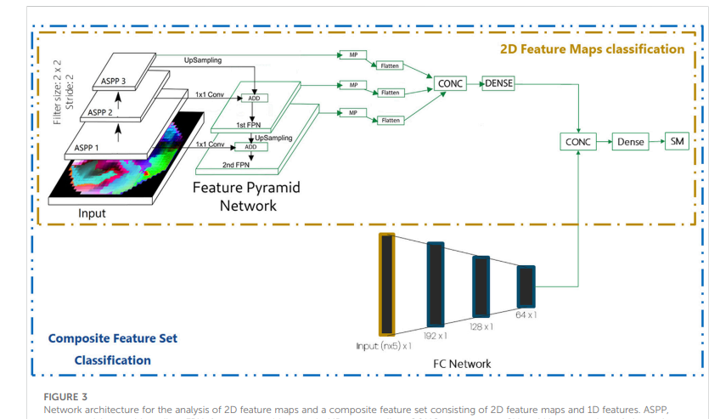

Slide 18
REPRESENTATION OF 3D VIDEOS
Converts 3d to 2d maps.
3 scalar values obtained per time frame.(raw signal divided into 3 sub bands)
32*32 grid spatial with three channels per time frame.
TIME FRAME = for example take 2s . so computed mean of all samples in that time frame.
INPUT : 32*32*3 per time frame.
Exploit spatial ,spectral,temporal simultaneoulsy

Slide 19
CNN-LSTM
ARCH:
4conv -> BN+MP ->2conv ->BN+MP ->1conv ->BN+MP->LSTM+1D temp conv layer -> conc ->dense->SM.
Without FPN1,FPN2 only CNN7 is sent to LSTM.
For video we are using temporal convolution
in keras layer name is TimeDistributed
TimeDistributed preserves temporal information
So we add CNN layers inside TimeDistributed layers
So input to this would be t x m x m x c.(t*32*32*3)
Then you apply TimeDistributed layers.
After all cnn layers at last when you add Flatten()
Output : t x len(Flatten())
This has extracted spatial information and preserved temporal information.
Then we pass it to LSTM and 1D conv to extract temporal information.

Slide 20
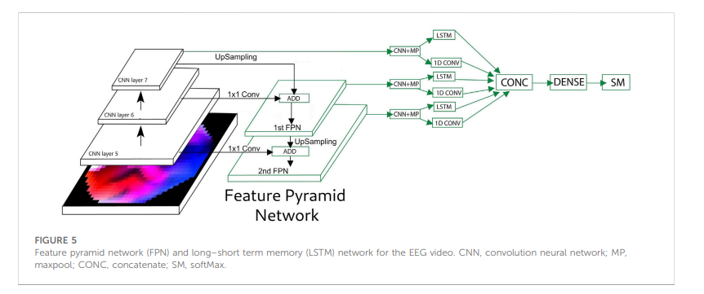
FPN-LSTM

Slide 21
Evaluation
LOSS FUNCTION : binary cross entropy
OPTIMIZER : adam
SLR : 0.001(initially)
SPLIT of DATA SETS:
EEG BASELINES, MENTAL ARTHMENTIC : 64% train,18% val, 18%test.
PD : 10 rounds of 10-fold cross validation
EMotion dataset : leave-one-subject-out method

Slide 22
DATASETS
EEG Baselines :
2 classes - eyes open,closed
218 samples from 109 patients
1min per sample.
Sample rate : 160 HZ
Electrodes : 64
EEG Mental arithmetic :
2 classes - rest,arithmetic task
72 samples from 36 patients
3min per sample.
Sample rate :500HZ
Electrodes : 16

Slide 23
DATASETS
Parkinson’s :
2 classes - Eyes open , close.
27 patients
Sample rate : 500 HZ
Electrodes : 64
Emotion dataset :
2 classes - positive , negative
15 patients(7 males,8 females ages 23.27+-2.37)
4minute per sample
Sample rate : 200HZ
Electrodes : 62

Slide 24
Results
DATA SET | Best Representation | 2D+1D | 2D | 1D
EEG Baselines | 3d | mobility | complexity | K-NN
Mental Arithmetic | 3d | mobility | mobility | k-NN
Parkinson | 1d | DE | DE | KNN
Emotion | 2d+1d | Hurst | Hurst | AD

Slide 25
BASIC INFO

Slide 26
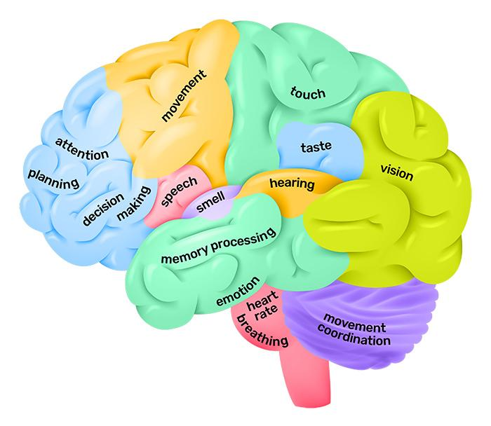
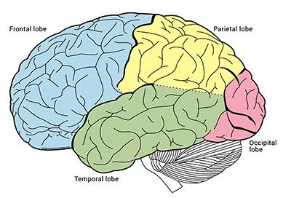

Slide 27
Brain divided into 4 lobes.
Frontal : emotions,decision making,solving,reasoning
Parietal : Touch ,temperature, pressure, pain
Temporal : hearing, language, forming memories.
Occipital : visual processing center.

Slide 28
Brain Waves
Delta
States : Deep sleep, trance, unconscious.
Theta
States: Creative, day dreaming, meditation.
Alpha
States: Alertness. (no activity but staying alert)
Beta
States :thinking, solving, decision making, processing info.
Gamma
States : Processing rich info task.

